Slide 1
Trends in Birth Rates: A 20-Year Analysis
(1994-2014)
DA-11
Tim Spratt
Notes:
"Good evening everyone! I appreciate you being here for this presentation. My name is Tim, and tonight, I am excited to share my research on current birth rate trends with you.

Slide 2
Information of Dataset
United States
This dataset contains information from the United States between January 1, 1994 and December 31, 2014.
Notes:
This dataset comprises data sourced from the United States spanning from January 1, 1994, to December 31, 2014, providing a robust foundation for investigating long-term trends and shifts in birth rates across the nation.

Slide 3
7,670 Days
85,386,227 Births
DA-11
Data by the Numbers
Notes:
In this dataset, I examined data spanning 7,670 days, amounting to a total of 85,386,227 births. This comprehensive analysis provides a detailed insight into the trends and patterns of birth rates over the specified period.

Slide 4
Analyzing Trends
DA-11
Extended Look at Births Per Year
Average Births Per Month
Average Births Per Day
Total Births Per Year
Highest Births on Specific Dates
Top 10 Highest and Lowest Births
Special Dates
Key Trends Analyzed in Birth Rate Data
Notes:
For this project, I used Excel, PowerBI, and Python to paint a picture of these 7 different trends. Let’s dive right in to the data

Slide 5
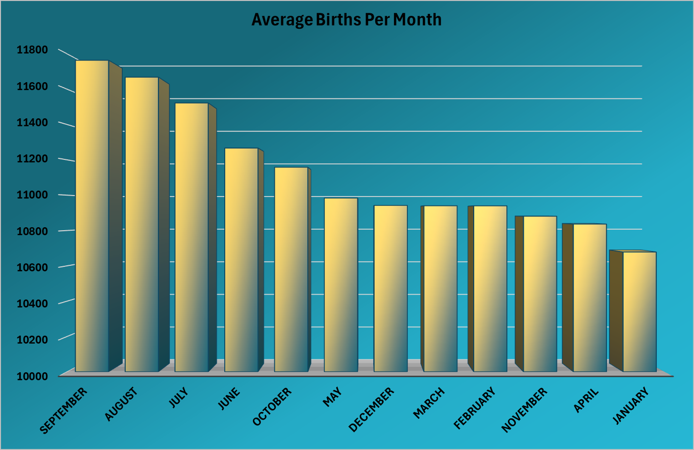
Births Per Month Jan-Dec
September
11,763
January
10,677
December, March, February 10,939 - 10,942
Notes:
Our first trend is Births per month. When analyzing the data, i found that September is at the top with 11,763 which is not all that surprising. Afterall, september is 9 months after new years day. One major resolution people have is starting or expanding their family. In the very same month that people decide to have a family, they actually have the least amount of children. January is the lowest with 10,677. The months of December, March, and February are the closest months in the dataset. They are all separated by only 3 births, which range from 10,939 to 10,942. Despite February having 3 days less than january, and 2 days less than april and november, it had higher average births than those months. This makes sense for November because of the extended time that thanksgiving occupies, which will reduce the number of births, but April is an odd one. For now, Lets move onto the next trend

Slide 6
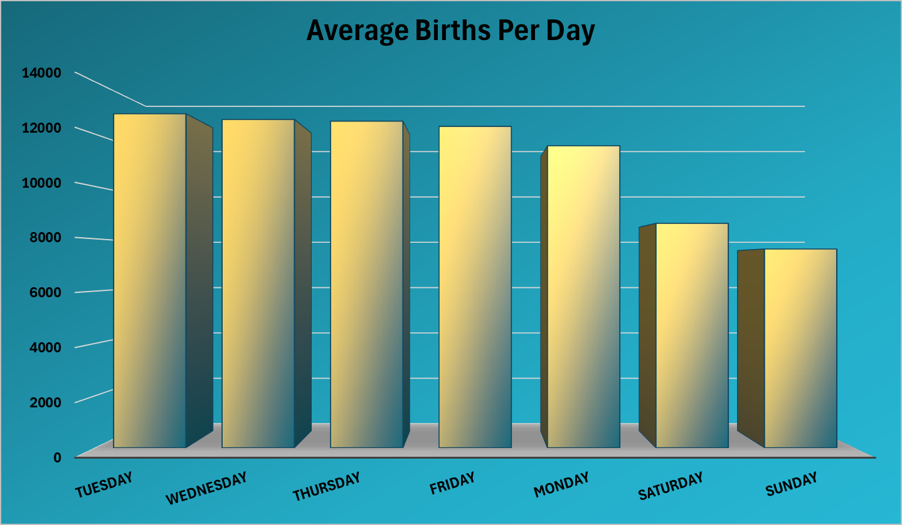
Births Per Day Sun-Sat
Tuesday
Leading the way with
12,787
Sunday
Lowest total with 7,610
Notes:
For the average births on days of the week, Tuesday was the highest with 12,787 while sunday was the lowest at 7,610. That’s a difference of 5,177 which is quite a big difference. Monday rounded out the weekdays at 11,562.
Here we see that Saturday started the weekend trend of dropping off dramatically. With this, we can conclude that the weekend definitely is not a popular choice to have babies, and people still don’t like Mondays

Slide 7
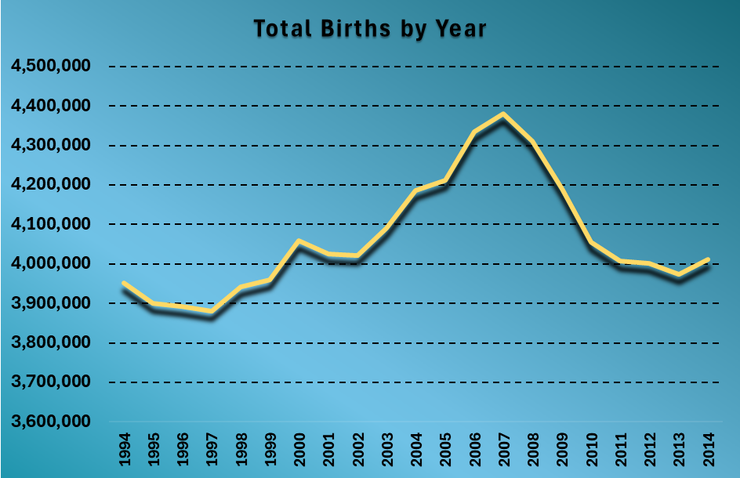
Births by Year 1994 - 2014
2007 was the year with the highest total births.
Recession peaked in December 2007, lasting until June 2009.
Notes:
Next, I looked at the total births per year for our dataset. 2007 had the highest overall births with a total of 4,380,784. After that, It never increased in total and has only seen a decline until 2014. I think we can all remember what the recession of 2007 did and how it felt. It is clearly evident in this dataset that it affected birth rates as well. If people feel like they are financially unwell or unsure about the future, it impacts their decisions to have children. Because of this trend, I wanted to try and look at a bigger picture than just these 20 years…

Slide 8
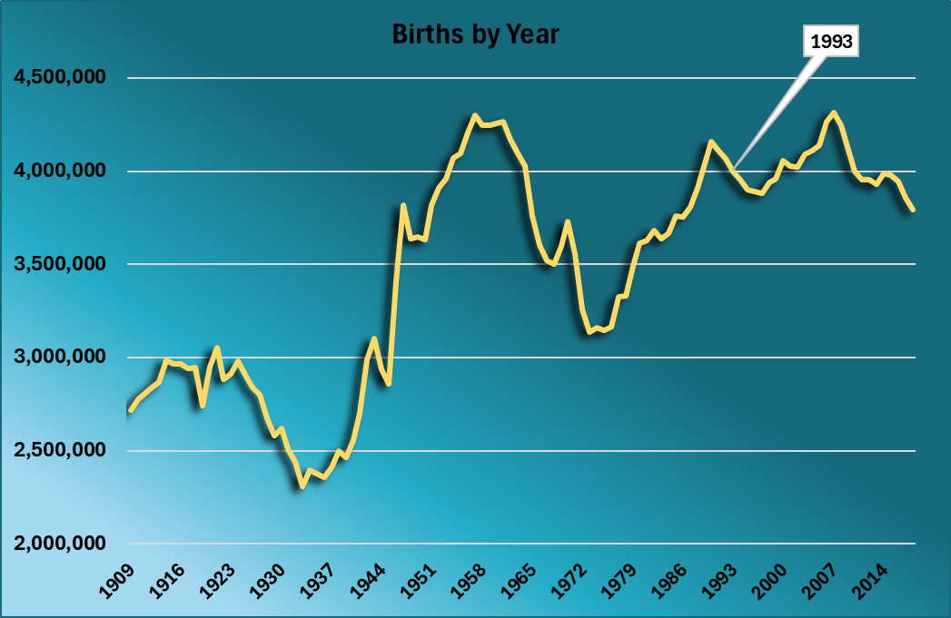
Births by Year 1909 - 2018
2007 was the year with the highest total births.
1957 is second with a near tie of 2007
1933 is the lowest with 2.3 millions births
Biggest influx was between 1945 and 1947
Notes:
I found another dataset that covered births from 1909 to 2018. I didn’t use this dataset for all my questions, because it strictly covered the births by year, not by day, so it was very limiting. In this graph, we see that 2007 had the highest births. The next highest year was 1957 at 4.3 million even. That is a perfect 50 year anniversary. Looking at our current year, we are hitting birth numbers that we have not seen since the 1980’s. There are many other interesting years in this graph. For instance, in 1957 We start to see a sharp decline once again. The reason the number started declining after 1957 was because of our involvement in the Vietnam War which lasted until 1975. Because of that, People state that the 1970’s were perhaps the worst decade of most industrialized countries’ economic performance since the great depression. There was not an economic depression, but economic growth rates were considerably lower than previous decades.This chart definitely correlates with that seeing the numbers climb near the very end of the 70’s. Moving back a bit further in time, When we look at world war 2 which was from 1941 to 1945, we see a sharp drop-off as well, but from 1945 to 1947, a span of 2 years, we see the single biggest increase from 2,858,000 births to 3,817,000. That is a jump of nearly 1 million. My guess is many men came back from the war and wanted to start or continue their families.
Now, let’s move away from births by year, and start looking at births by date…

Slide 9
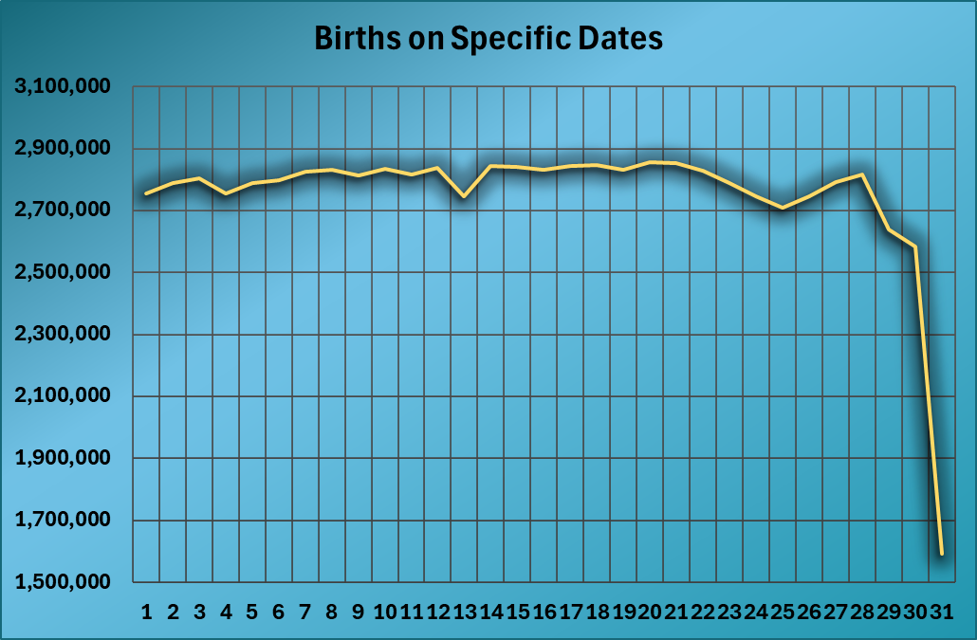
Births on Specific Dates
Dates of Importance: 1, 4, 13, 25, 29, 30, 31
DA-11
Dates of Birth
Notes:
On this slide, we are looking at the total births on a particular date. We can see some interesting trends here, with the biggest difference obviously being the 29th, 30th, and 31st. These are obviously low because the 31st only happens 6 times a year, and february skews the data with not having the 29th or 30th as well. But there are some other numbers that are particularly interesting.
For instance, we can see a decline on the 4th. When I looked up the rankings of births on the 4th, 16 out of the 19 lowest births were on July 4th. But something was slightly interesting about this as well…Only the first 2 were july 4th, followed by 3 consecutive september 4ths, all which belonged to a monday. Now, in case you don’t know, September 4th celebrates a very important holiday which is…national macadamia nut day! Besides that, I found no other patterns that made the 4th lower.
The date of the 1st drops because of New years, and the 25th drops because of Christmas and sometimes thanksgiving. But one very interesting number is the 13th, which takes a dramatic dip, which led me to another question. Do people avoid or choose certain dates based off of skepticism? I found a partial answer to that question with the next trend….

Slide 10
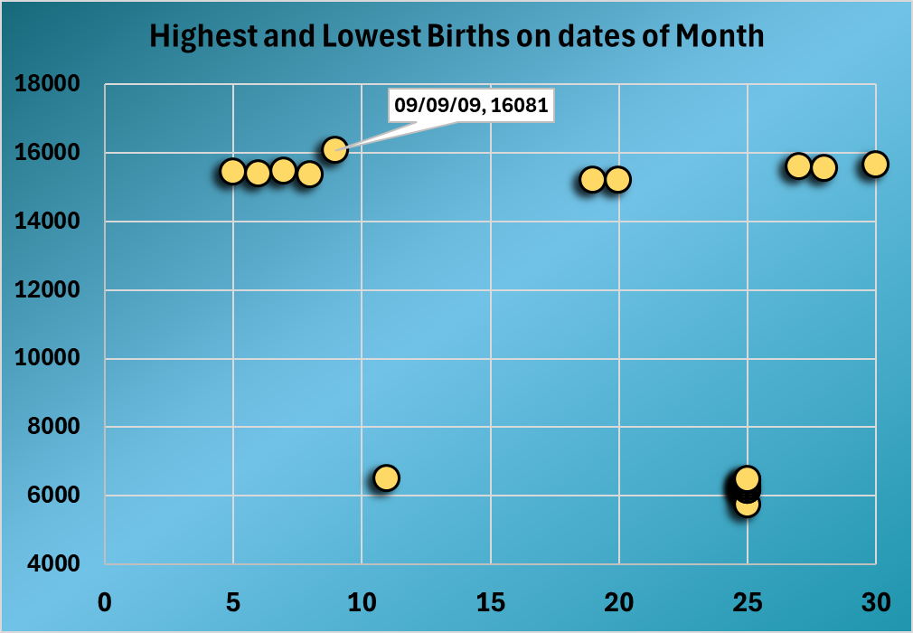
Top 10 Highest and Lowest Births
All 9 births of 25 were on December 25th.
DA-11
Births by Date of Month
Notes:
With this chart, we are looking at the top 10 highest and lowest births on certain dates. Each one of these circles represents a date that was the highest or lowest. As we can see here, There is no clear pattern for the highest births as they are all spread out, and they occur in different months with no significance to them, but as far as the lowest, we can see 9 of the 10 are grouped together and they all land on the 25th. Those dates of the 25th are all of Christmas day, which makes sense. The lowest date was December 25th, 2007 with 5,728 births(which was during the peak of the recession). For reference, the next lowest date is Christmas 2010 with 6,159 births. That is a difference of 431, so not a small difference.
The interesting outlier in this dataset is the lowest value that lands on the 11th. That date belongs to March 11th, 2011. It was a Sunday, so it makes sense to be a low number, but why that day over any other day of Christmas? Well, on the date of March 11th, 2011, there was a 9.0 earthquake that hit Japan which resulted in a Tsunami that killed nearly 20,000 people and caused the Fukushima Nuclear Power Plant accident. That was over in Japan, so did it affect births over here in the US? It’s hard to tell, but at the same time, that almost seems too coincidental to ignore. The highest overall landed on the date of 9/9/9, and that is a pattern that is too hard to ignore, which brings me to the next trend…

Slide 11
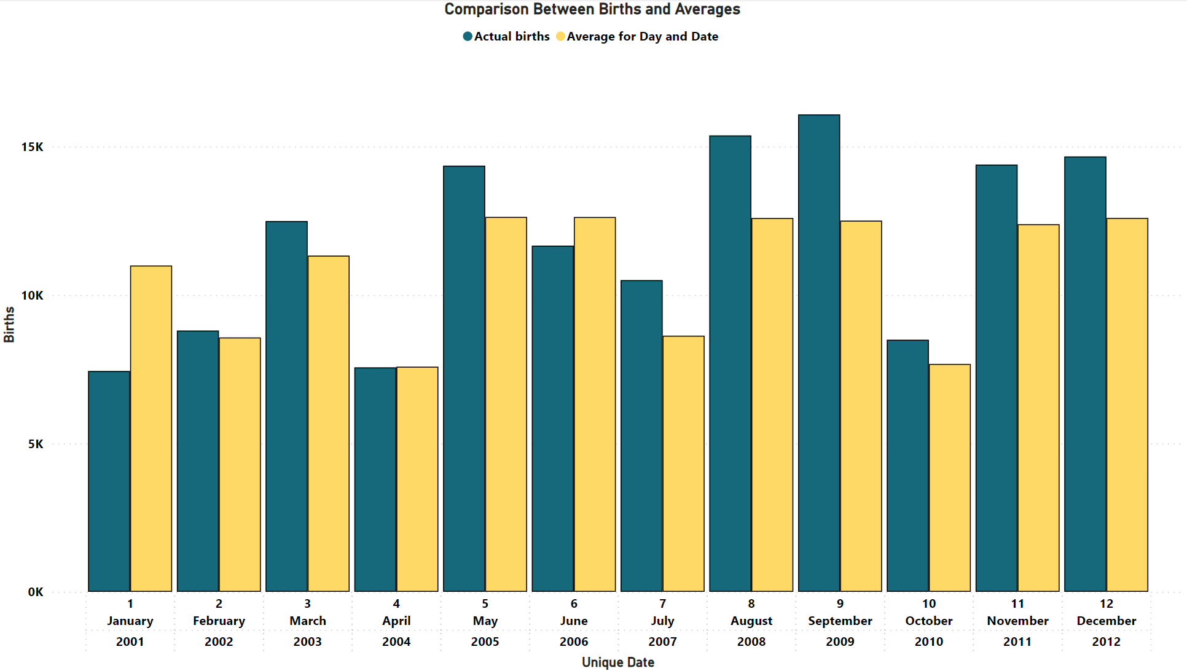
Analyzing Patterns
Average Births
Average births were compared cross referencing dates and days.
Special Births of Matching Dates
Actual Births
January, April, and June were the only months that did not beat the average.
01/01 02/02 03/03 04/04 05/05 06/06 07/07 08/08 09/09 10/10 11/11 12/12
Notes:
After seeing that 9/9/9 had the highest total births of any date, I decided to analyze all repeating birth numbers which are: 1/1/1, 2/2/2, and so on…The average amount of births for the day are represented with the yellow color, and actual births are the blue color. I acquired this data by matching the dates with the days (for instance, since 1/1/1 was on a monday, I got the average of all mondays that landed on the first, that way, weekends and other days would not influence the numbers).
Looking at this data, it is apparent that some definitely had more births than the average for that date, and some did not. As we know, 9/9/9 led the pack, 8/8/8 was a close second, and 1/1/1 was the absolute lowest. We can see here that the values of 2, 4, 7, and 10 are all lower, as they all landed on saturdays and sundays. On this next slide, we take a closer look at some of the days to see why the patterns are the way they are.
1/1/1 was monday
2/2 was saturday
3/3 was monday
4/4 was sunday
5/5 was thursday
6/6 was tuesday
7/7 was saturday
8/8 was friday
9/9 was wednesday
10/10 was sunday
11/11 was friday
12/12 was wednesday

Slide 12
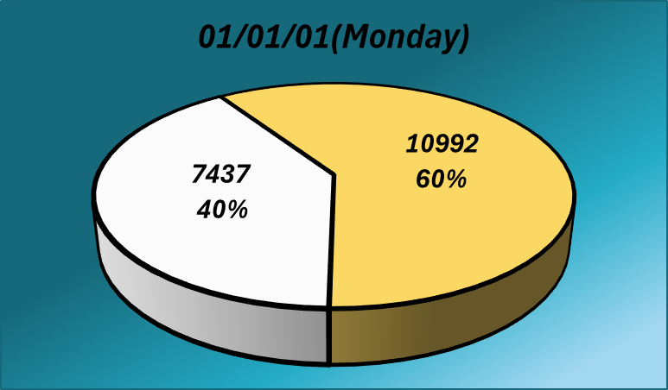
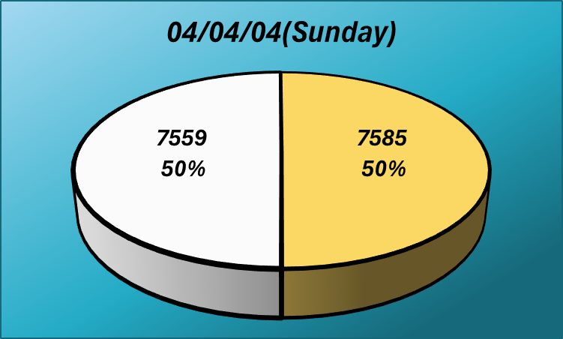
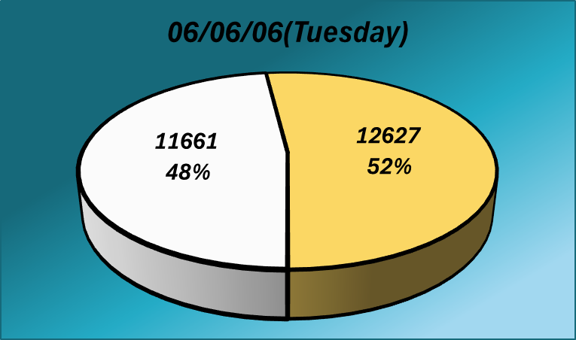
3 Lowest Averages
01/01/01
04/04/04
06/06/06
New Years Day
Day of the week is Sunday
No reason besides superstition
Notes:
Here, we look at the lowest averages from the prior dataset. 1/1/1 makes sense because it was new years day. Holidays always tend to have lower rates of birth. 4/4/4 was also a sunday, and sundays statistically had the lowest amounts of births. Now here’s where it gets interesting. There was no reason for 6/6/6 to have as few births as it did. There were 11,661 births on the 6th, but there were 13,004 on the 5th and 13,693 on the 7th which are both higher than the average. As we remember, June was the 4th highest month, Tuesday was the highest day, and if not for 2007, 2006 has the most amount of births in our dataset. There were no reasons for it to be as low as it was besides human superstition. Now, let’s look at the highest averages.

Slide 13
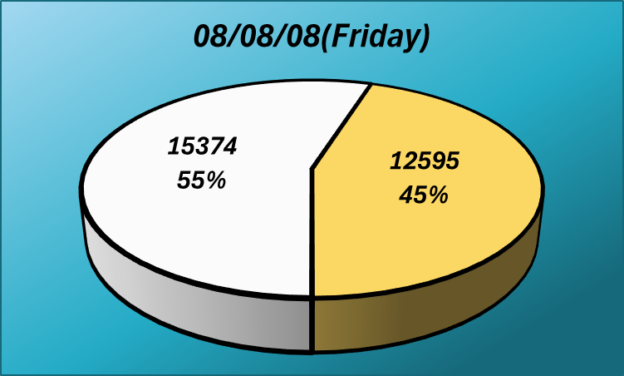
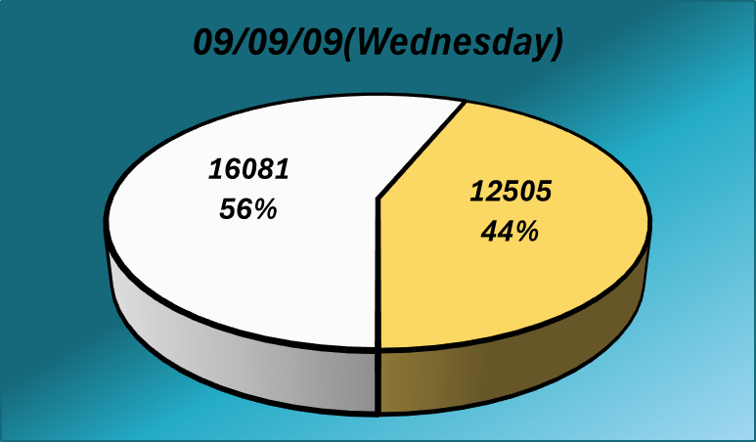
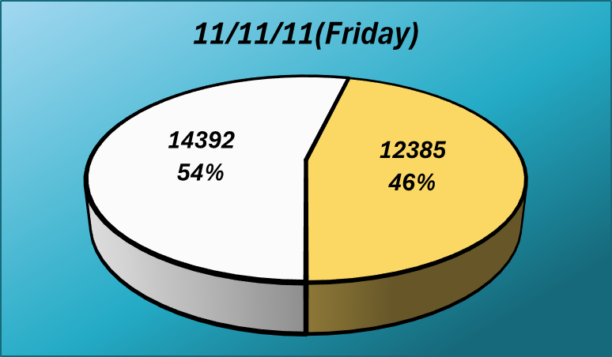
3 Highest Averages
08/08/08
09/09/09
11/11/11
Second greatest difference amongst all special dates
Most births of any day in dataset
Once in a century matching birth
Notes:
These are the highest averages of special dates. We see that both 8/8/8 and 11/11/11 were on fridays, so without skewing the data too much by factoring in the weekend, we can only look at the day before. The day before 8/8/8, there we 13,859 births, a difference of 1,515. The day before 11/11/11, there were 11,978 births. A difference of 2,414. Friday usually has an average of 12,304, so these two dates are higher than the average Friday. For the date of 9/9/9, the tuesday before had 13,555 and the thursday after had 14,887. All three days are higher than the averages so it is safe to say that people were really aiming for this date. Looking at all these results, I think it is safe to say that numbers do play a role in when some people choose to have a baby.

Slide 14
Final Thoughts
DA-11
Case Observation
Notes:
In conclusion, this analysis of birth rates has unveiled valuable insights into trends spanning the past two decades. The data reveals significant fluctuations influenced by economic factors, historical events, and even specific dates or days of the week. Notably, certain periods within this timeframe showed remarkable increases or decreases in birth rates, corresponding to specific events or periods. This study not only underscores the dynamic nature of birth rates but also emphasizes the critical importance of fostering a healthy environment for the general public.

Slide 15
Thank You!
Sources:
https://github.com/fivethirtyeight/data/tree/master/births
https://www.statista.com/statistics/195908/number-of-births-in-the-united-states-since-1990/
https://www.cdc.gov/nchs/data-visualization/natality-trends/index.htm
DA-11
Thank You
Questions are welcome at this moment.
Notes:
Thank you for your time and attention. I hope you enjoyed tonight’s presentation.

Slide 16
07 Trends
Analyzing Trends
DA-11
Data
Key Trends Analyzed in Birth Rate Data
Notes:
For this data, I analyzed 7 different trends. These trends are: Average births per month and per day, an extended look at total births by year and on specific dates, the top 10 highest and lowest births, and special dates. For this project, I used a combination of: Excel, PowerBI, and Python. Let’s dive right in to the data

